Slide 1
BUSQOM 1080: Data Analysis for Business
Fall 2020
Lecture 4 (9/1)
Professor: Michael Hamilton

Slide 2
Course Specifics
Outline for today:
Topic: For Loops [15 Mins]
Topic: If/Else Statements [15 Mins]
Recap of what we’ve learned so far [15 Mins]
Misc. Course Updates

Slide 3
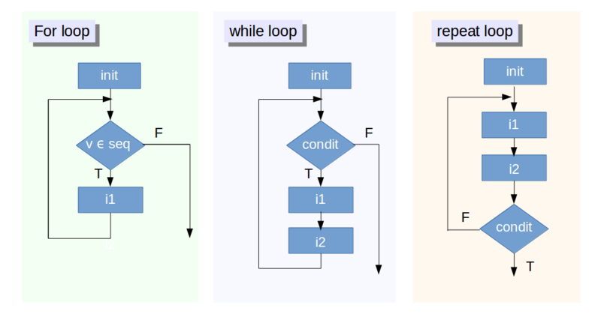
Topic: For Loops
Looping (also known as cycling, iterating) is simply automating a multi-step process by organizing sequences of actions and grouping the parts that need to be repeated.
Loop types: For, While, doWhile etc.
General Advice: Learning about loops gives you a detailed view of what it is supposed to happen at the elementary level as well as they provide you with an understanding of the data that you’re manipulating.
After you have gotten a clear understanding of loops, work to get rid of them!
Diagram:
Structure of a for loop

Slide 4
Topic: For Loops
A for loop repeats a block of code a set number of times. Very useful for looking through data programmatically (examples to follow!)
Anatomy of a for loop:
Initialization: The state of things before the loop executes
Loop Variable & Loop Vector: R keeps track of the number of loop iterations (block code executions) with a loop variable. After each iteration, R updates the Loop Variable by looking into the Loop Vector. When the iteration reaches the end of the vector the loop terminates.
Body of Loop: This is the code that is executed at each loop iteration
Diagram:
Structure of a for loop

Slide 5
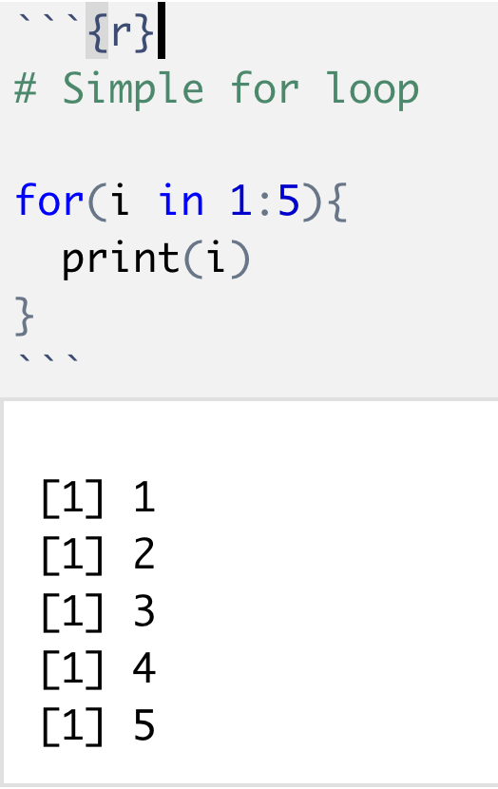
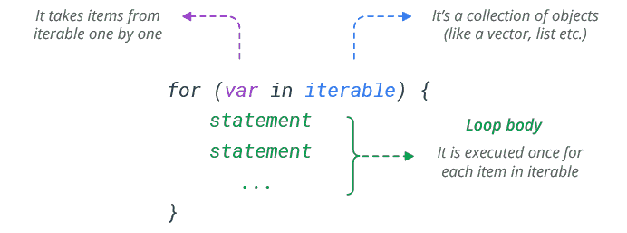
Topic: For Loops
Example 1: Basic Loop
Syntax of the a for loop, bolded in blue are the special ingredients
Example break down
Initialization: Nothing here, there’s nothing defined before the execution of the for loop.
Loop Variable & Loop Vector: The loop variable here is “i” and the loop vector is 1:5 (equiv. to c(1,2,3,4,5)).
Body of Loop: The code that’s being repeated at each iteration is the statement print(i) which prints out the value of i.

Slide 6
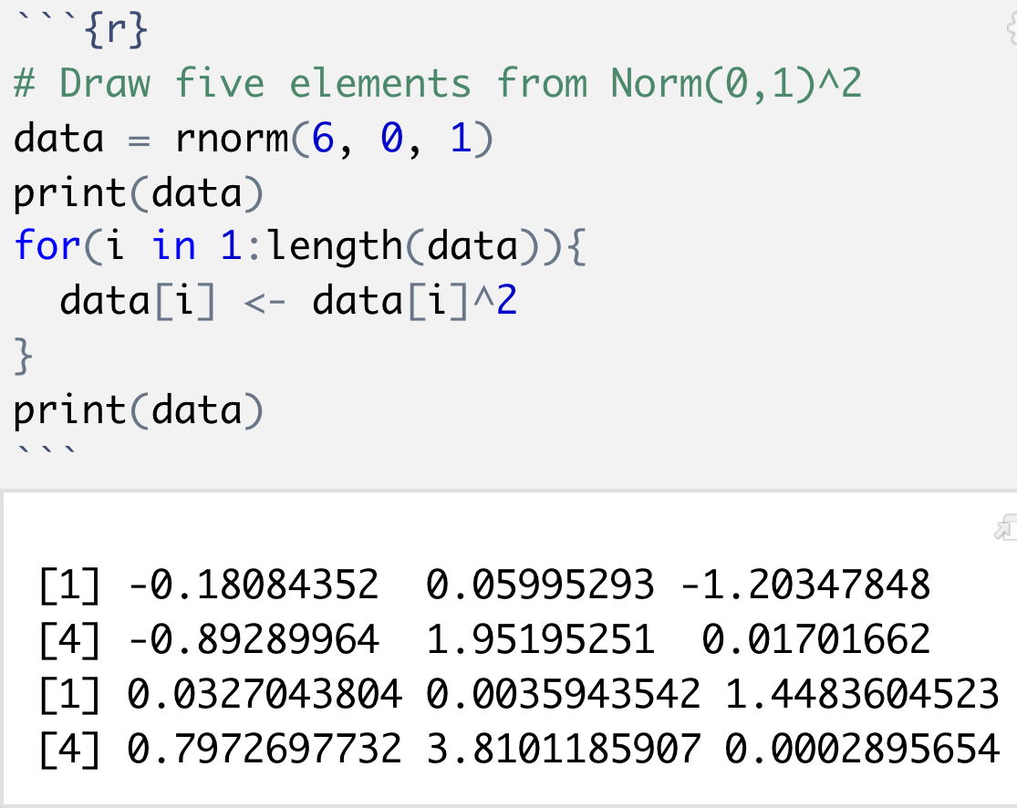
Topic: For Loops
Example 2: Manipulating vectors using loops
Example break down
Initialization: The vector data is set to a vector of six elements, drawn according to a Norm(0,1).
Loop Variable & Loop Vector: The loop variable here is again “i” and the loop vector is 1:length(data) (equiv. to c(1,2,3,…, length(data)).
Body of Loop: The code that’s being repeated at each iteration is the statement
data[i] <- data[i]^2
which at each loop iteration, accesses the i^{th} element of data (NOTE i changing!), squares it and overwrites the previous value of data[i] with it.
In the Zoom session + Group Activity + Assignment 3 we will practice with for loops.

Slide 7
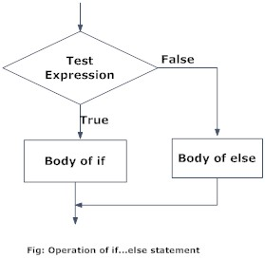
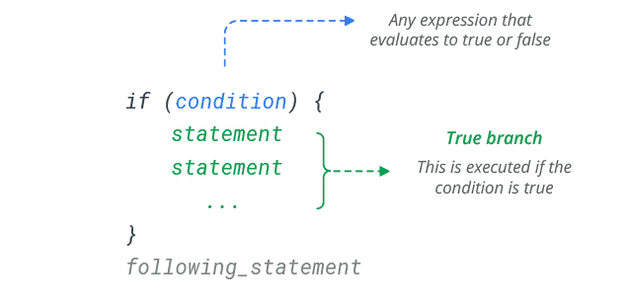
Topic: If/Else Statements
Logical Flow of If/Else
Often, you need to execute some statements only when some condition is met (especially in conjunction with functions and for loops!). The If/Else is the way to conditionally run code in R
Syntax in R

Slide 8
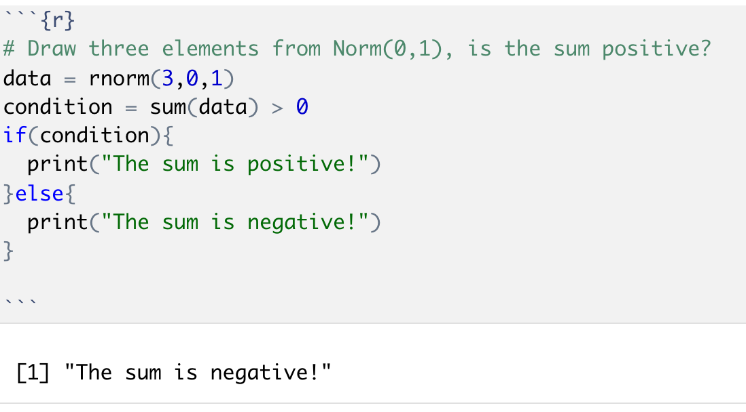
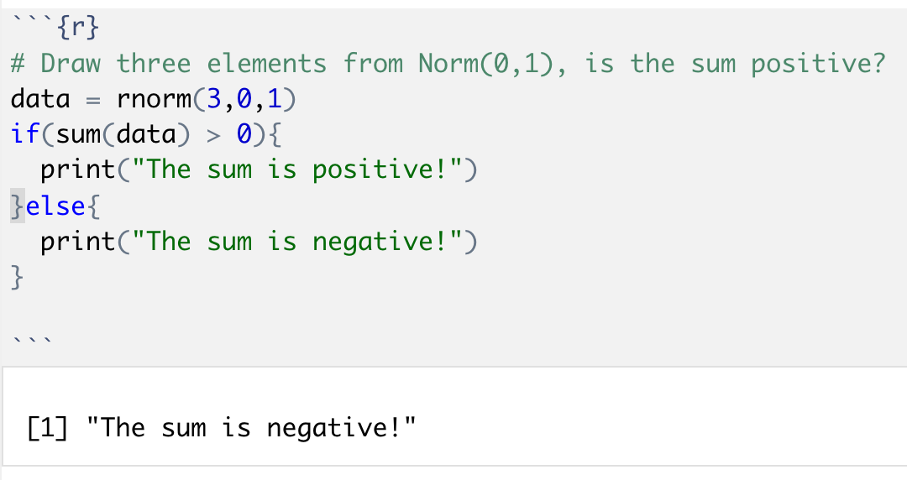
Topic: If/Else Statements
Let’s look at some examples!
Things to note:
The if(…) takes in a boolean, here that boolean is named “condition”. The code between the braces {…} only evaluates if that boolean is TRUE, else it skips that code!
This is programmatic! We never peak inside the variable data, R does it for us!

Slide 9
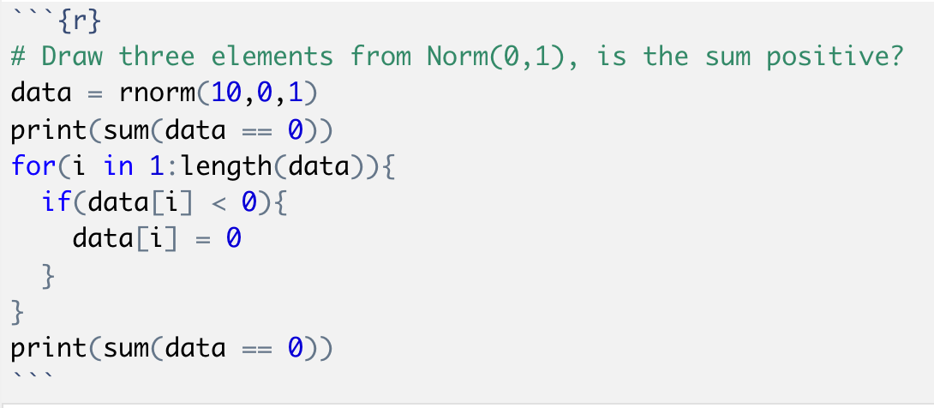
Topic: If/Else Statements
Let’s combine this with loops
Loops let us look through a vector
The if/else statements lets us make decisions on each element of the vector
Things to note:
The for loop repeats the if statement once for each element of the vector data.
The if statement checks if the element of data is less than 0, if it is then the code inside the braces runs. That code sets the element of data[i] to 0.
End result: This code sets all the negative values of data to 0.
Note: There’s equivalent vectorized code!
> data[data < 0] = 0

Slide 10
Summary
That completes the Introduction to R “Bootcamp”
Topics covered:
Interacting with R, R Notebooks – Lecture 2 as
Data Types – Lecture 2
Logical Operations – Lecture 2
Vectors – Lecture 2
Subsetting Vectors – Lecture 2
Lists + Matrices – Lecture 3
DataFrames – Lecture 3
Writing Functions – Lecture 3
For loops – Lecture 4
If/Else Statements – Lecture 4
These are the fundamentals; we will practice with these concepts extensively to reinforce them! Lots more to learn!

Slide 11
For Next Time
In the zoom session we will do many more examples for loops and if statements, especially with Dataframes!
Assignment 2 is due on Friday (9/4)
Assignment 3 will be posted shortly, due the Friday after (9/11)
Thanks!

